Slide 1
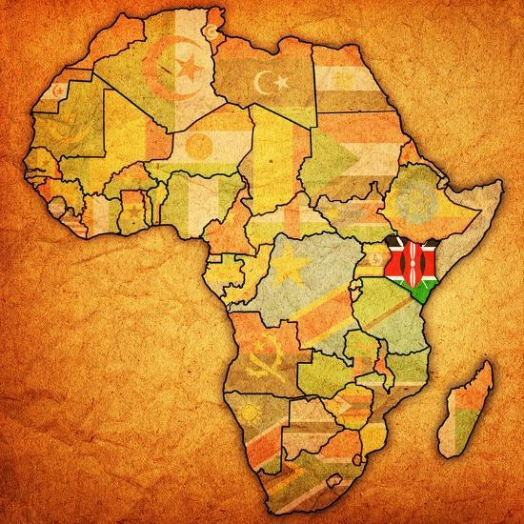
Forecasting Food Insecurity in Kenya
William Itotia
24079944
MSC Data Science Thesis
https://github.com/William-Itotia/Forecasting-Food-Insecurity-in-Kenya

Slide 2
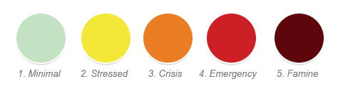
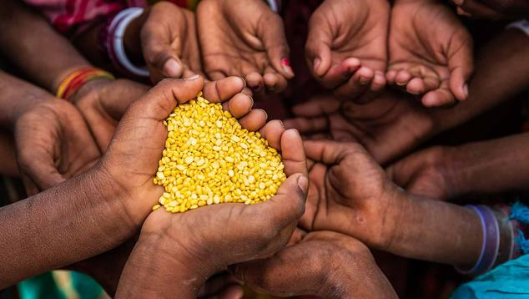
Introduction
Food insecurity is defined as the absence of consistent access to sufficient, safe, and nutritious food for an active and healthy life (Manikas, Ali and Sundarakani, 2023).
This research aims to forecast food insecurity in Kenya using the Integrated Food Security Phase Classification (IPC) scale as the target variable, a five-point scale ranging from 1 (food secure) to 5 (famine-affected) (Feffer, Kapoor and Dodt, 2021).

Slide 3
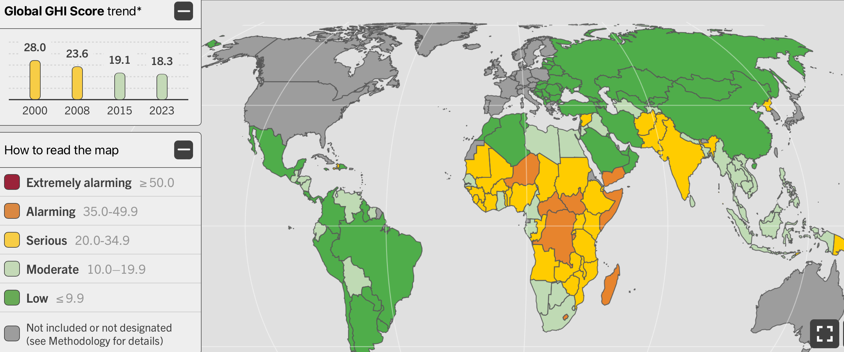
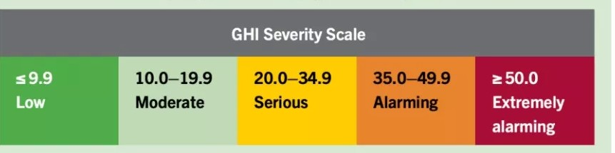
Motivation
Kenya ranks 103rd out of 125 countries on the 2025 Global Hunger Index with a score of 25.9, indicating a serious hunger crisis, with 36.8% of the population undernourished and 17.9% of children under five stunted (Global Hunger Index, 2024).
Effective forecasting of food insecurity in Kenya could enable timely interventions, reducing the negative impact and ultimately lowering the number of people affected.

Slide 4


Dataset and Ethical Considerations
To ensure ethical data usage, all datasets were sourced from publicly accessible platforms and contained no personally identifiable information.
Four datasets were integrated for this research:
IPC Classification Data (FEWS NET): 150,944 rows and 25 columns, containing the IPC target variable.
NDVI Dataset (data.humdata.org): 68,688 rows and 8 columns, capturing vegetation cover across Kenya.
Rainfall Dataset (data.humdata.org): 131,544 rows and 15 columns, recording rainfall across different regions of Kenya.
Food Pricing Dataset (data.humdata.org): 17,632 rows and 16 columns, providing food commodity prices across Kenya.

Slide 5
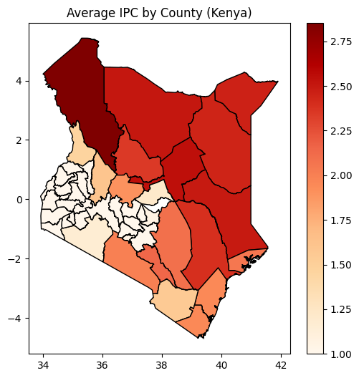
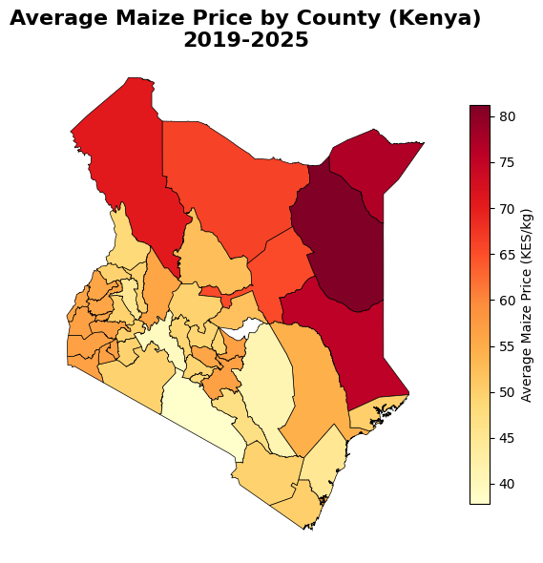
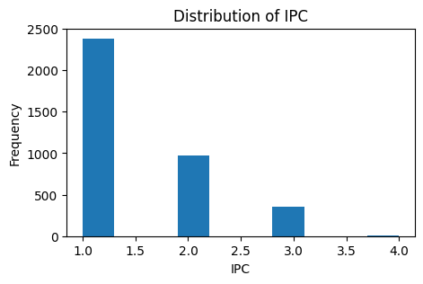
Data Analysis
The distribution of IPC ratings is notably imbalanced, indicating that the majority of areas in Kenya are not food insecure.
However, the maps reveal that the Northern region of Kenya is at the highest risk of food insecurity, recording the highest average IPC values, while Central and Western Kenya remain the most food secure.
This is further compounded by the fact that the Northern region also records the highest maize prices in the country, which is likely a contributing factor to the elevated levels of food insecurity in that area.

Slide 6

Data Preprocessing
Step 1: IPC Data Cleaning Duplicates removed via mode aggregation; quarterly data forward-filled to monthly frequency.
Step 2: Climate Data Integration NDVI and rainfall merged, enriched with lag variables, 6-month averages, and drought indicators.
Step 3: Maize Price Imputation Three-tier filling (county → regional → national) applied, achieving 100% coverage across all 47 counties.
Step 4: Final Integration All datasets merged on County and Month, producing 3,726 complete observations across 14 features.

Slide 7
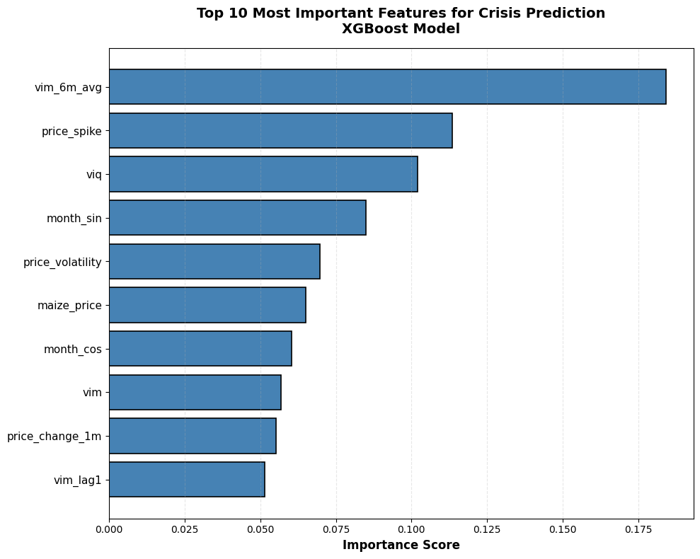
Modelling
Random Forest and XGBoost were selected for several key reasons:
Mixed Data Handling: Both naturally handle mixed data types without extensive preprocessing.
Non-Linear Relationships: They capture complex interactions, such as how vegetation health and food prices combine to drive crises.
Dataset Size: 3,726 observations suits tree-based models but is too small for deep learning.
Interpretability: Both provide feature importance scores, offering critical insight into what drives food insecurity.
Class Imbalance: XGBoost's built-in sample weighting was essential given only 5% of observations represent crisis events.

Slide 8
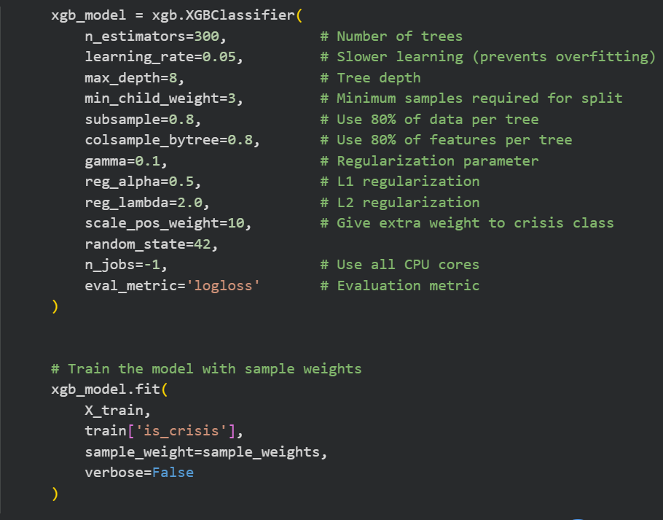
Hyperparameters and Training
Due to the time series nature of the dataset, a date-based train/test split was applied, with all observations from 2024-01-01 onwards reserved as test data.
The figure beside illustrates the hyperparameter tuning process for XGBoost, the better performing model.

Slide 9
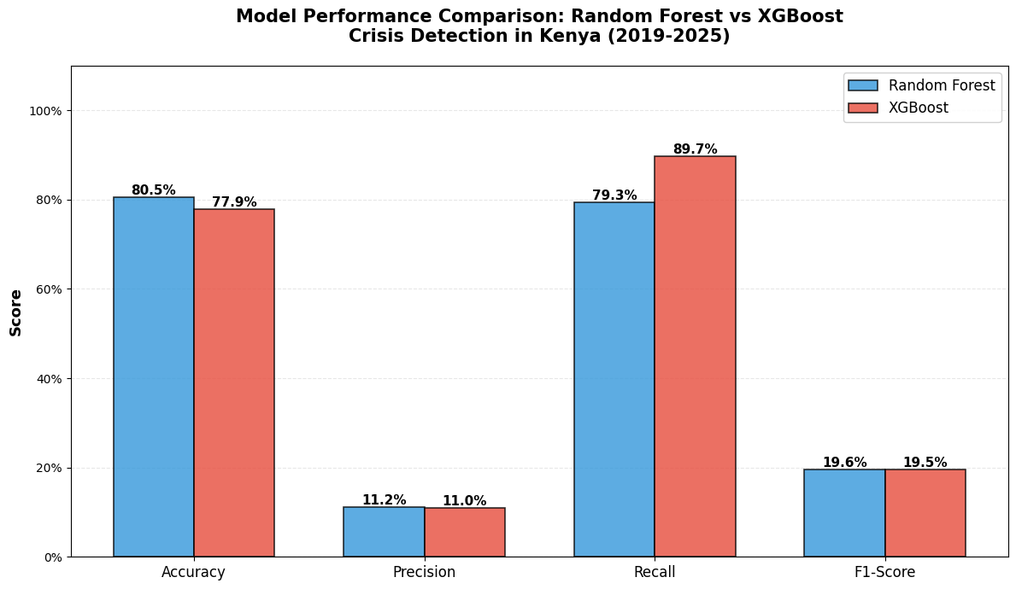
Model Interpretation
XGBoost was selected over Random Forest despite lower overall accuracy, due to its superior recall score a more critical metric in this context. At 89.7%, this outperforms comparable studies such as Christensen, Wagner and Langhals (2021), whose neural network achieved a recall of 0.81. As supported by the literature, a false negative carries a far greater cost than a false positive given the potential loss of lives, making XGBoost's ability to correctly identify crisis events the decisive factor.

Slide 10
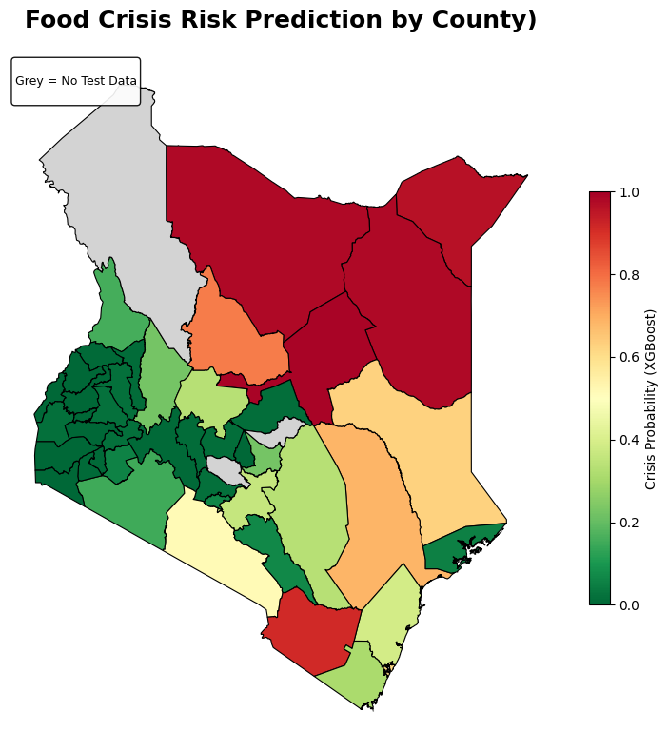
Summary and Conclusion
In conclusion, this project successfully demonstrated that machine learning can be leveraged to forecast food insecurity in Kenya by integrating climate, vegetation, and food price data. As illustrated in the figure, the North-Eastern region of Kenya remains at the highest risk of food insecurity, highlighting where interventions are most urgently needed. Ultimately, this system shows that combining readily available data sources can provide actionable early warnings for humanitarian organisations, enabling more timely and targeted responses to food crises.

Slide 11
References
Christensen, C., Wagner, T. and Langhals, B. (2021). Year-Independent Prediction of Food Insecurity Using Classical and Neural Network Machine Learning Methods. AI, 2(2), pp.244–260. doi:https://doi.org/10.3390/ai2020015.
Feffer, M., Kapoor, P. and Dodt, S. (2021). Predicting food insecurity.
Global Hunger Index (2024). Kenya. [online] Global Hunger Index - peer-reviewed annual publication designed to comprehensively measure and track hunger at the global, regional, and country levels. Available at: https://www.globalhungerindex.org/kenya.html.
Manikas, I., Ali, B.M. and Sundarakani, B. (2023). A systematic literature review of indicators measuring food security. Agriculture & Food Security, 12(1). doi:https://doi.org/10.1186/s40066-023-00415-7.

Slide 12
The End
Any Questions?

